Slide 1
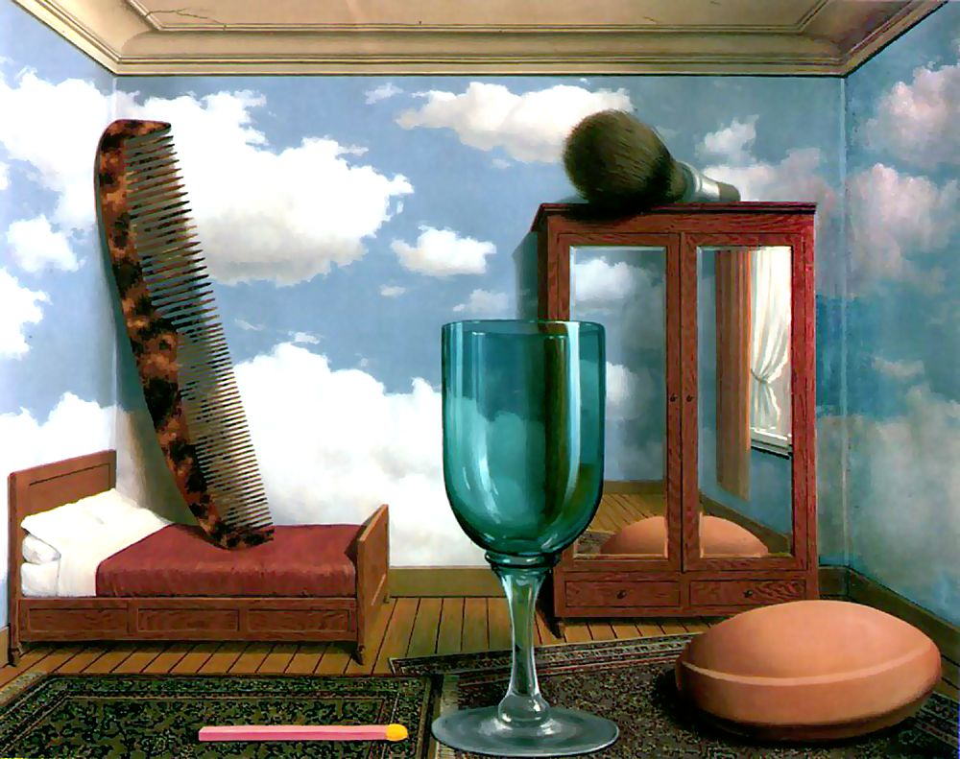
Single-view metrology
Magritte, Personal Values, 1952
Many slides from S. Seitz, D. Hoiem

Slide 2
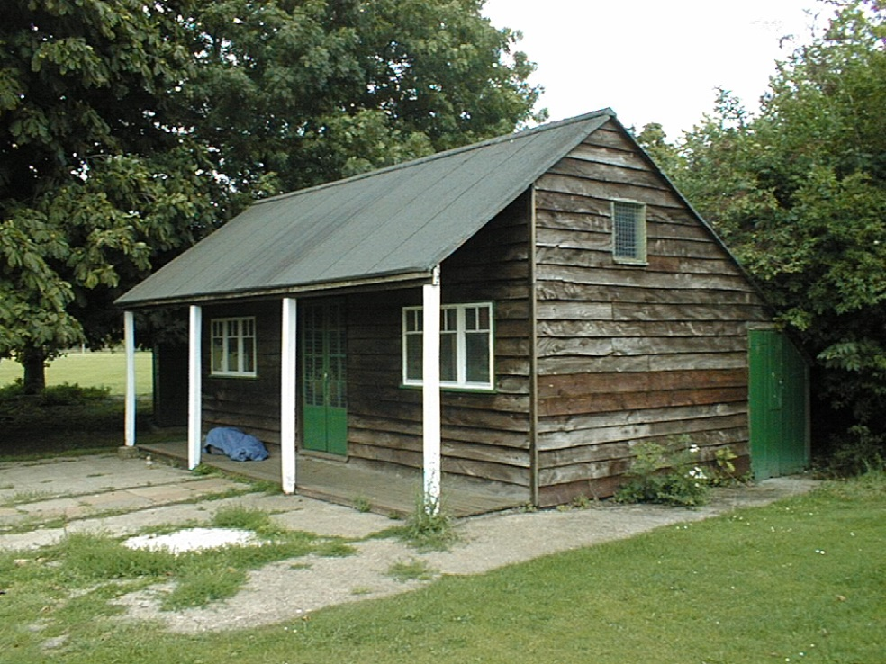
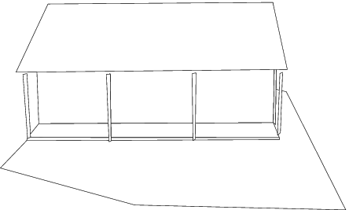
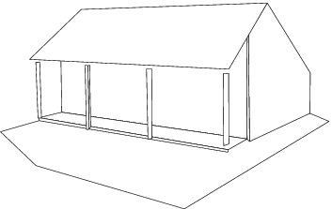
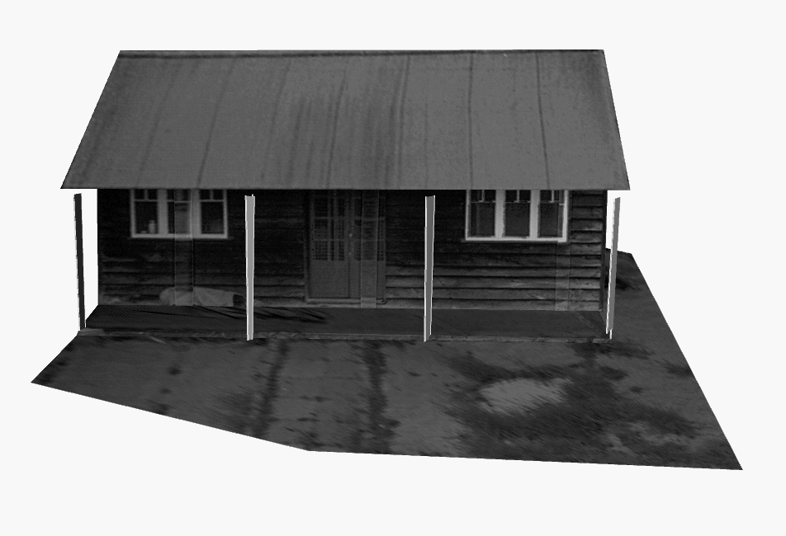
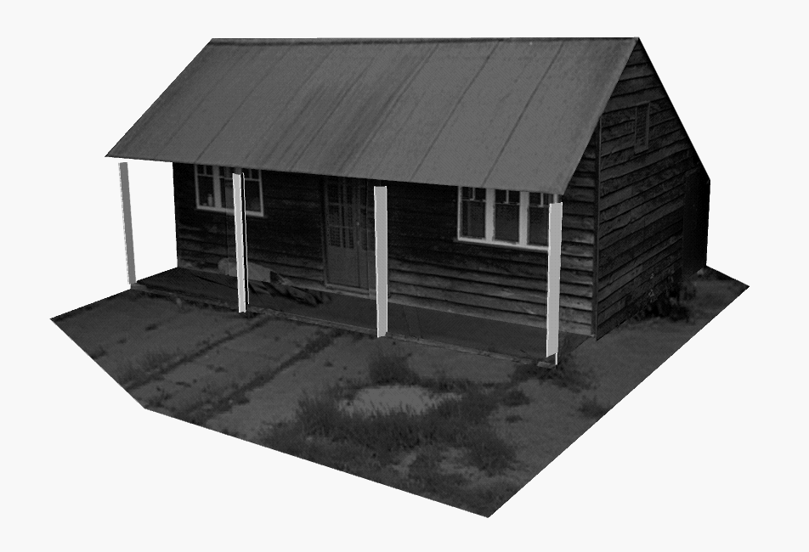
Application: Single-view modeling
A. Criminisi, I. Reid, and A. Zisserman, Single View Metrology, IJCV 2000

Slide 3
Camera calibration revisited
What if world coordinates of reference 3D points are not known?
We can use scene features such as vanishing points
Slide from Efros, Photo from Criminisi

Slide 4
Camera calibration revisited
What if world coordinates of reference 3D points are not known?
We can use scene features such as vanishing points
Vertical vanishing
point
(at infinity)
Vanishing
line
Vanishing
point
Vanishing
point
Slide from Efros, Photo from Criminisi

Slide 5
Recall: Vanishing points
image plane
vanishing point v
camera
center
line in the scene
All lines having the same direction share the same vanishing point

Slide 6
Computing vanishing points
v
X₀
X_{t}
X∞ is a point at infinity, v is its projection: v = PX∞
The vanishing point depends only on line direction
All lines having direction d intersect at X∞

Slide 7
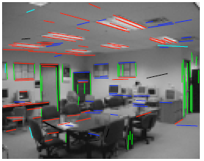
Calibration from vanishing points
Consider a scene with three orthogonal vanishing directions:
Note: v₁, v₂ are finite vanishing points and v₃ is an infinite vanishing point
.
.
v₁
v₂
v₃
Notes:
The third homogeneous coordinate of an infinite vanishing point is 0. Infinite vanishing points correspond to directions of lines that are parallel to the image plane.

Slide 8
Calibration from vanishing points
Consider a scene with three orthogonal vanishing directions:
We can align the world coordinate system with these directions
.
.
v₁
v₂
v₃

Slide 9
Calibration from vanishing points
p₁ = P(1,0,0,0)^{T} – the vanishing point in the x direction
Similarly, p₂ and p₃ are the vanishing points in the y and z directions
p₄ = P(0,0,0,1)^{T} – projection of the origin of the world coordinate system
Problem: we can only know the four columns up to independent scale factors, additional constraints needed to solve for them

Slide 10
Calibration from vanishing points
Let us align the world coordinate system with three orthogonal vanishing directions in the scene:
Each pair of vanishing points gives us a constraint on the focal length and principal point

Slide 11
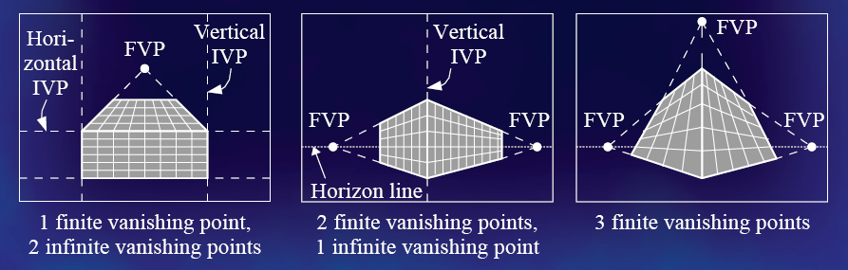
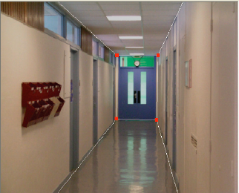
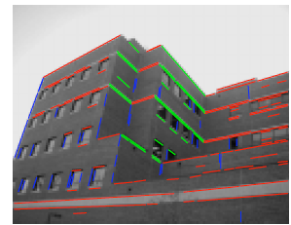
Calibration from vanishing points
Cannot recover focal length, principal point is the third vanishing point
Can solve for focal length, principal point

Slide 12
Rotation from vanishing points
Thus,
Get λ_{i} by using the constraint ||r_{i}||²=1.

Slide 13
Calibration from vanishing points: Summary
Solve for K (focal length, principal point) using three orthogonal vanishing points
Get rotation directly from vanishing points once calibration matrix is known
Advantages
No need for calibration chart, 2D-3D correspondences
Could be completely automatic
Disadvantages
Only applies to certain kinds of scenes
Inaccuracies in computation of vanishing points
Problems due to infinite vanishing points

Slide 14
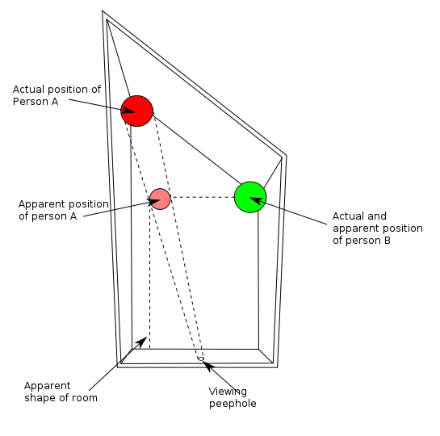
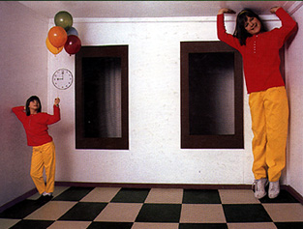
Making measurements from a single image
http://en.wikipedia.org/wiki/Ames_room

Slide 15
Recall: Measuring height
5.3
5
Camera height
4
3.3
3
2.8
2
1

Slide 16
Measuring height without a ruler
O
Z
ground plane
Compute Z from image measurements
Need more than vanishing points to do this

Slide 17
Projective invariant
We need to use a projective invariant: a quantity that does not change under projective transformations (including perspective projection)
What are some invariants for similarity, affine transformations?

Slide 18
Projective invariant
We need to use a projective invariant: a quantity that does not change under projective transformations (including perspective projection)
The cross-ratio of four points:
P₄
P₃
P₂
P₁

Slide 19
Measuring height
∞
scene cross ratio
T (top of object)
t
r
R (reference point)
C
H
b
R
image cross ratio
v_{Z}
B (bottom of object)
ground plane

Slide 20
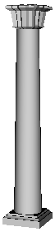
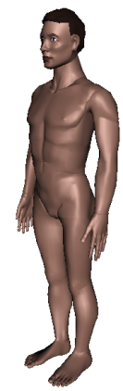
Measuring height without a ruler

Slide 21
v_{z}
r
vanishing line (horizon)
t₀
t
v_{x}
v
v_{y}
H
R
H
b₀
b
image cross ratio

Slide 22
2D lines in homogeneous coordinates
Line equation: ax + by + c = 0
Line passing through two points:
Intersection of two lines:
What is the intersection of two parallel lines?

Slide 23
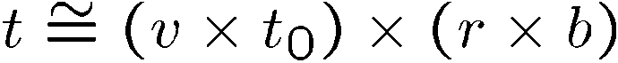
v_{z}
r
vanishing line (horizon)
t₀
t
v_{x}
v
v_{y}
H
R
H
b₀
b
image cross ratio

Slide 24
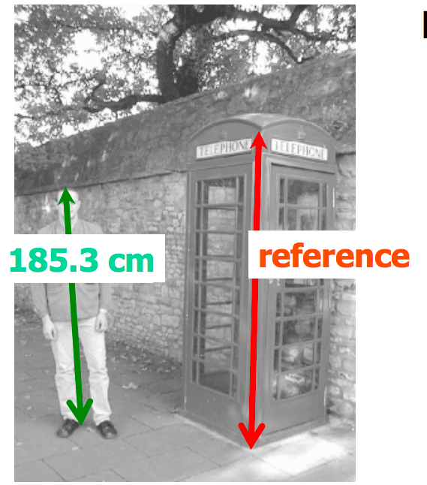
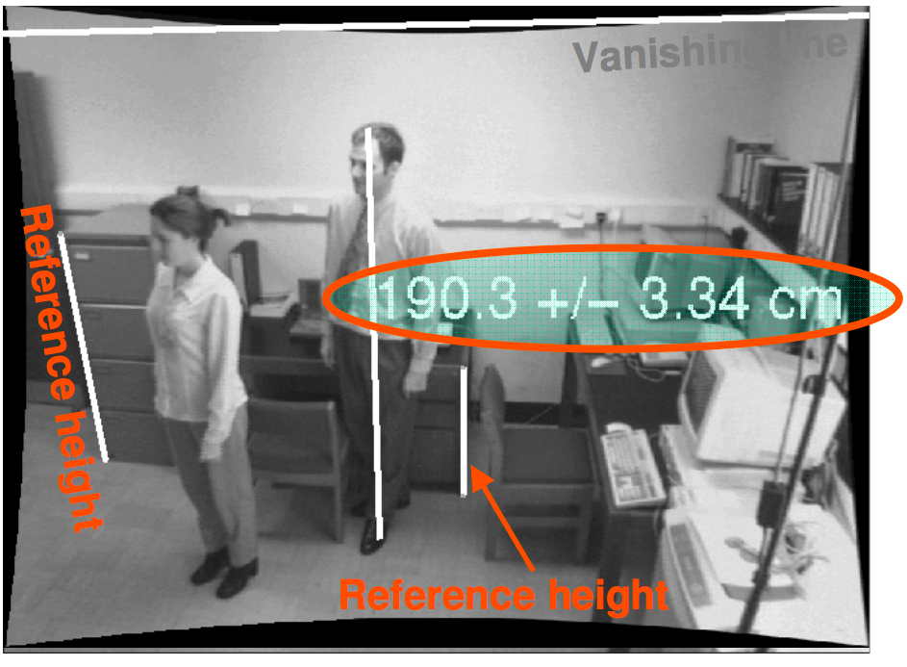
Examples
A. Criminisi, I. Reid, and A. Zisserman, Single View Metrology, IJCV 2000
Figure from UPenn CIS580 slides

Slide 25
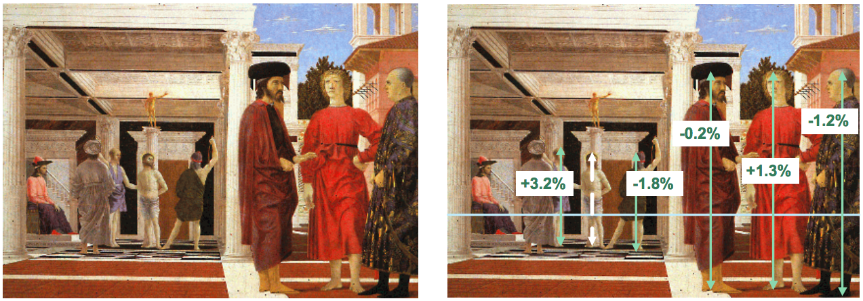
Another example
Are the heights of the two groups of people consistent with one another?
Measure heights using Christ as reference
Piero della Francesca, Flagellation, ca. 1455
A. Criminisi, M. Kemp, and A. Zisserman,Bringing Pictorial Space to Life: computer techniques for the analysis of paintings, Proc. Computers and the History of Art, 2002

Slide 26
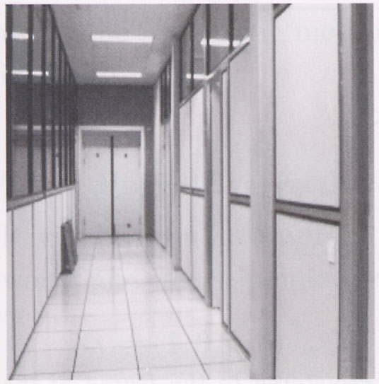
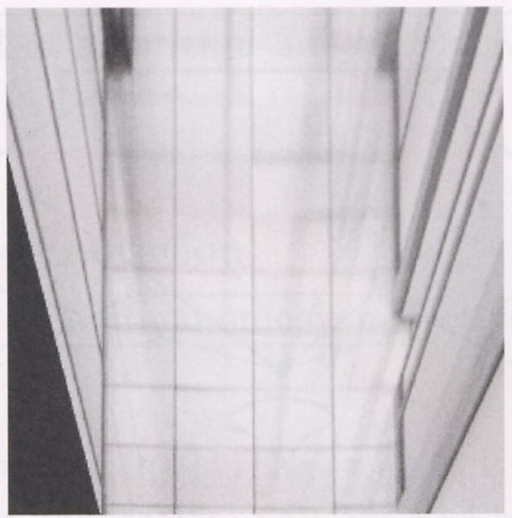
Measurements on planes
4
3
2
1
1
2
3
4
Approach: unwarp then measure
What kind of warp is this?
Notes:
homography!

Slide 27
Image rectification
p′
p
To unwarp (rectify) an image
solve for homography H given p and p′
how many points are necessary to solve for H?

Slide 28
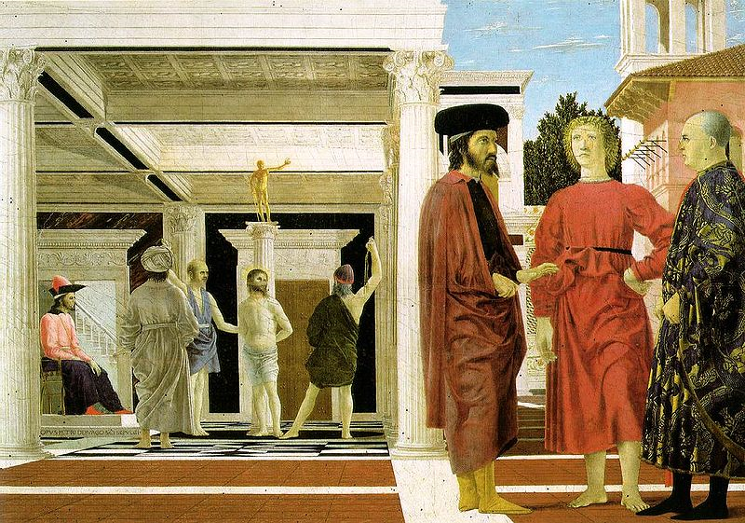

Image rectification: example
Piero della Francesca, Flagellation, ca. 1455

Slide 29
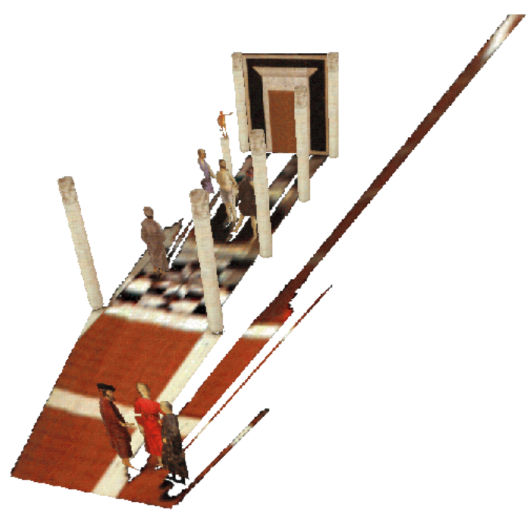
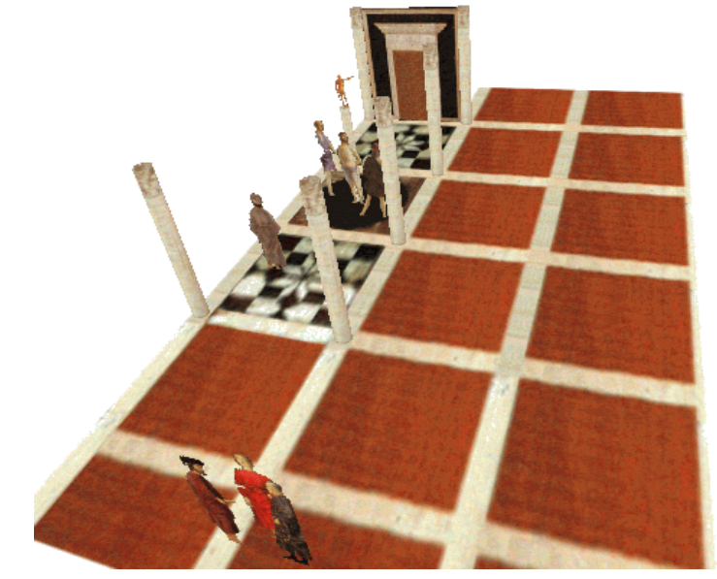
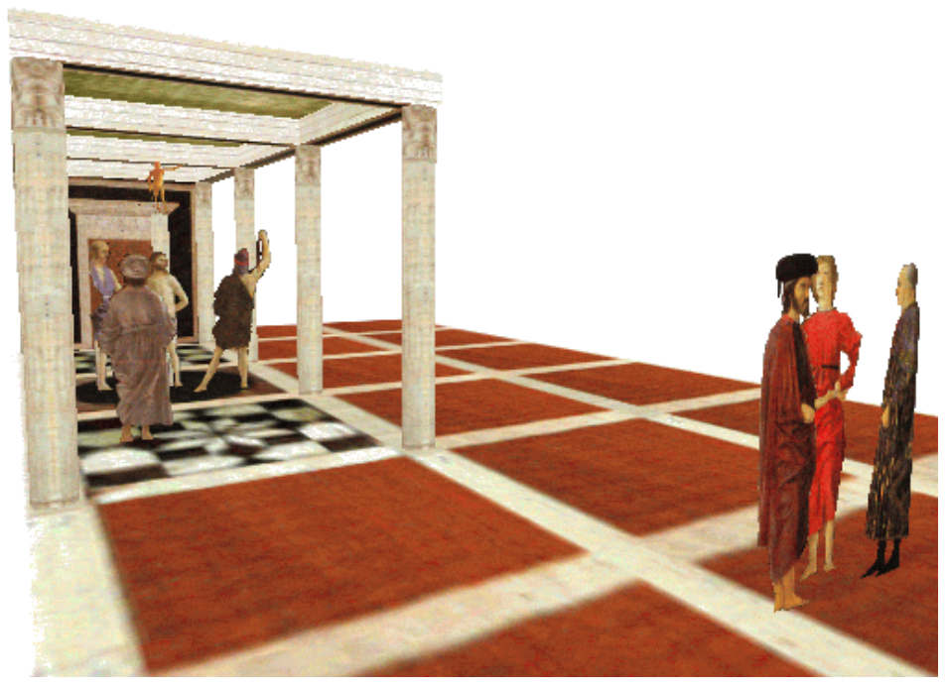
Application: 3D modeling from a single image
A. Criminisi, M. Kemp, and A. Zisserman,Bringing Pictorial Space to Life: computer techniques for the analysis of paintings, Proc. Computers and the History of Art, 2002

Slide 30

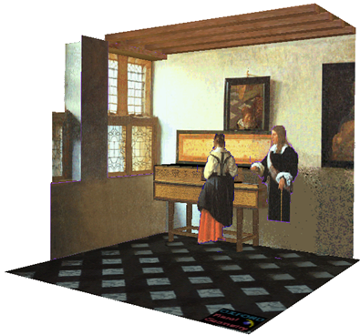
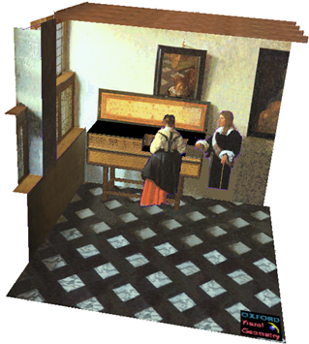
Application: 3D modeling from a single image
J. Vermeer, Music Lesson, 1662
A. Criminisi, M. Kemp, and A. Zisserman,Bringing Pictorial Space to Life: computer techniques for the analysis of paintings, Proc. Computers and the History of Art, 2002

Slide 31
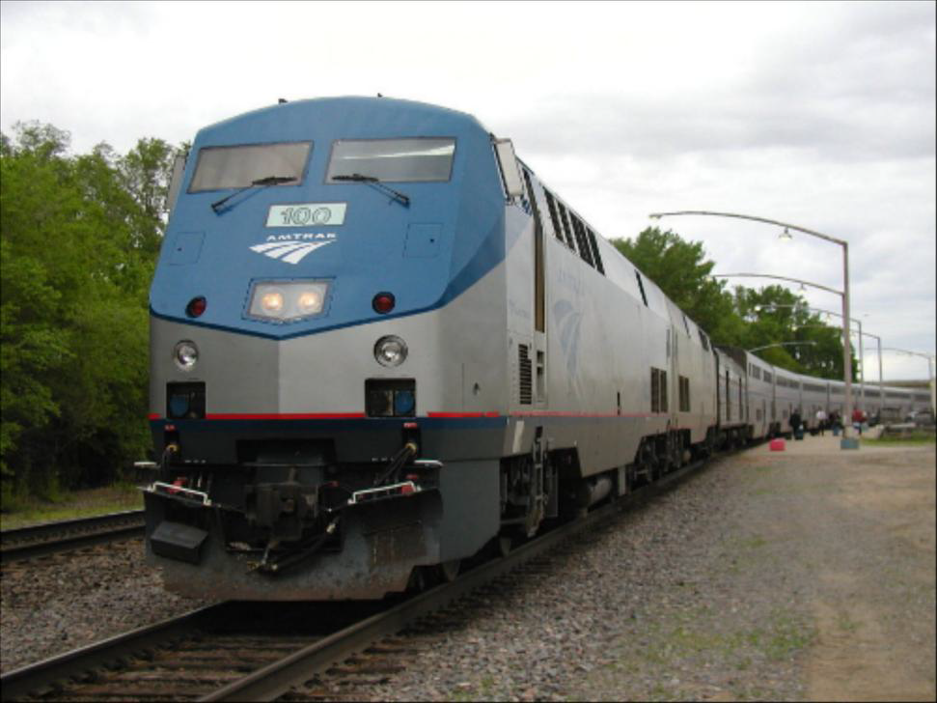

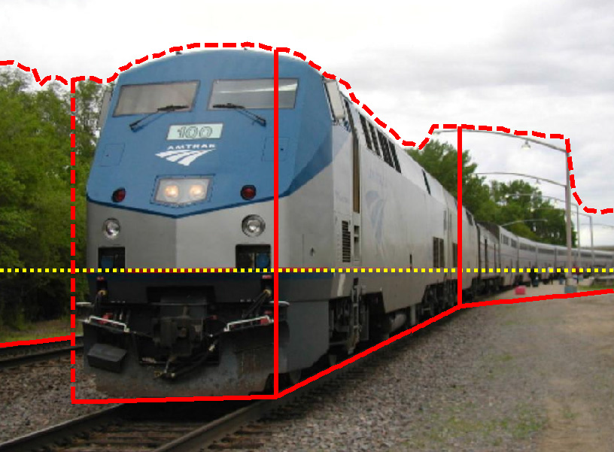
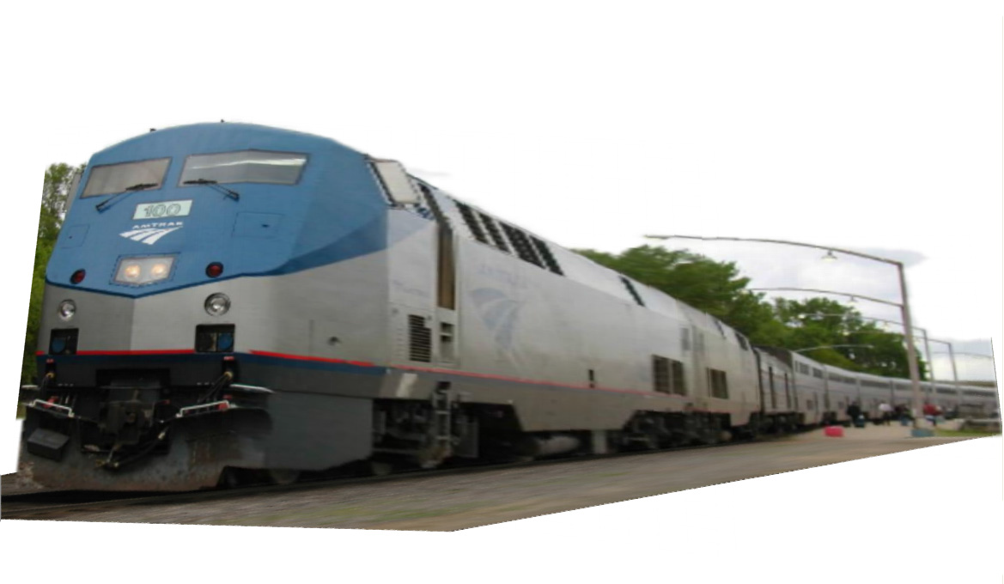
Application: Fully automatic modeling
sky
vertical
ground
D. Hoiem, A.A. Efros, and M. Hebert, Automatic Photo Pop-up, SIGGRAPH 2005.
http://dhoiem.cs.illinois.edu/projects/popup/popup_movie_450_250.mp4

Slide 32
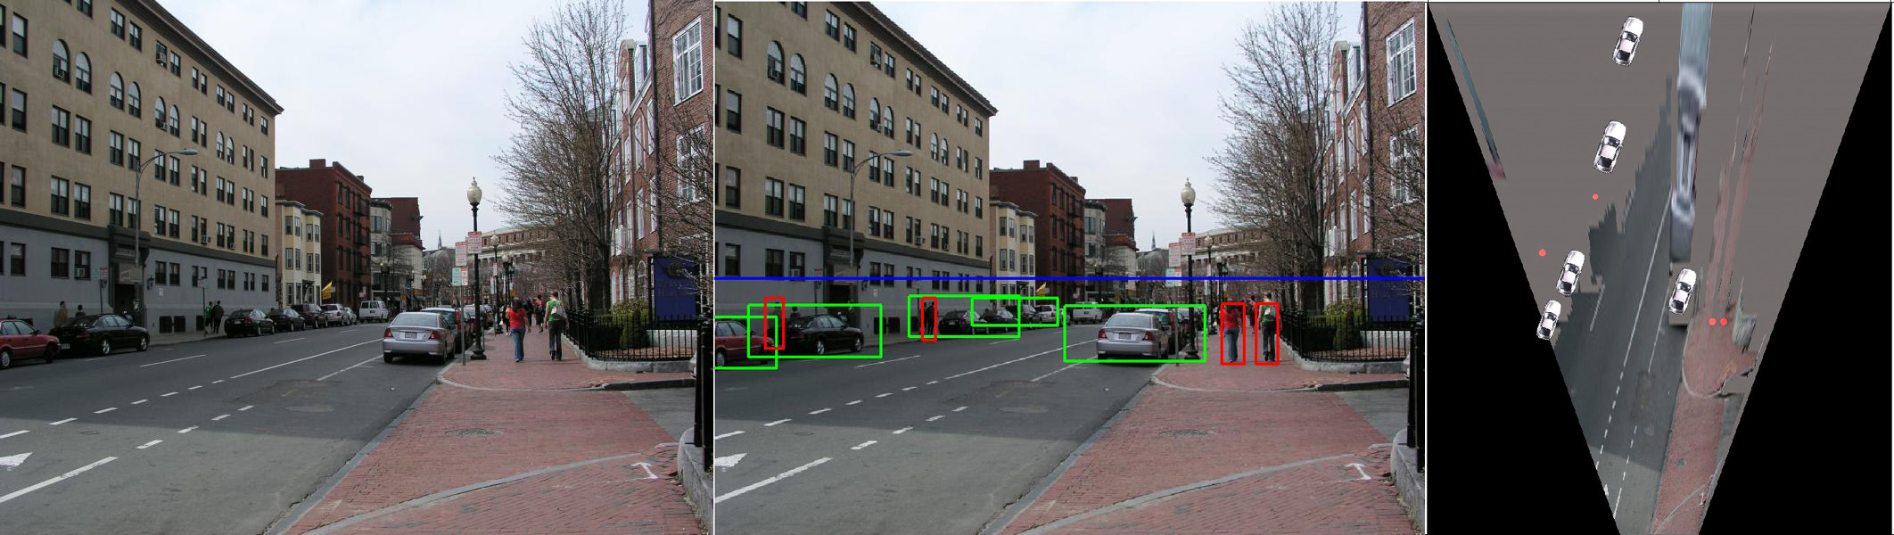
Application: Object detection
D. Hoiem, A.A. Efros, and M. Hebert, Putting Objects in Perspective, CVPR 2006

Slide 33
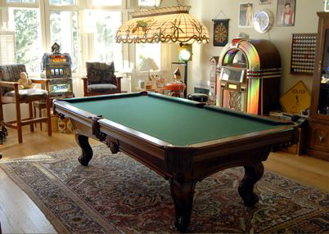
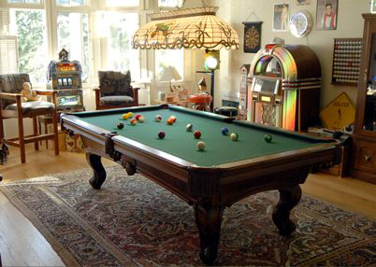
Application: Image editing
Inserting synthetic objects into images: http://vimeo.com/28962540
K. Karsch and V. Hedau and D. Forsyth and D. Hoiem, Rendering Synthetic Objects into Legacy Photographs, SIGGRAPH Asia 2011

